Slide 1
8. [Lab 5] Amazon Web Service
Training Workshop for IONIC framework

Slide 2
Objectives
Create an EC2 instance on the Amazon web service and use Putty to access the EC2 instance
Install stack in EC2 instance
Create Web Server in EC2

Slide 3
[Lab 5] Amazon Web Service Contents
8.1 Create an instance in AWS
8.1.1 Create EC2 instance in AWS
8.1.2 Access created instance using Putty
8.2 Install stack in EC2 instance
8.2.1 Install git
8.2.2 Install Node.js
8.2.3 Install MongoDB
8.3 Create Web Server in EC2

Slide 4
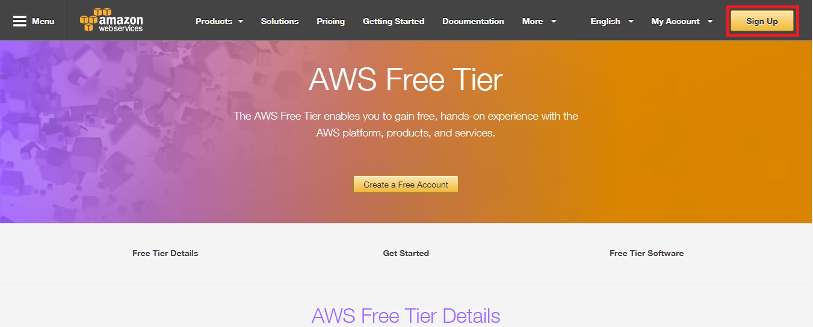
8.1 Create an instance in EC2
8.1.1 Create EC2 instance in AWS
Access AWS homepage and click login on console

Slide 5
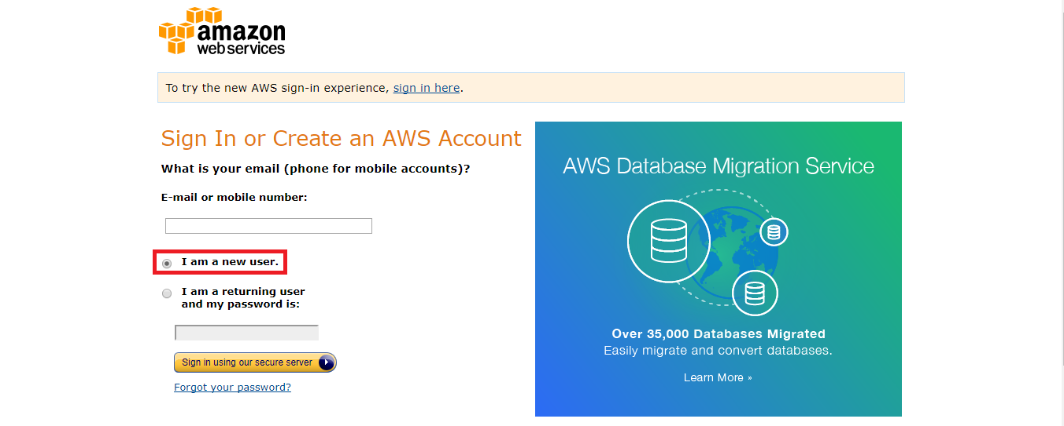
8.1 Create an instance in EC2
8.1.1 Create EC2 instance in AWS
Select a new user and join the membership

Slide 6
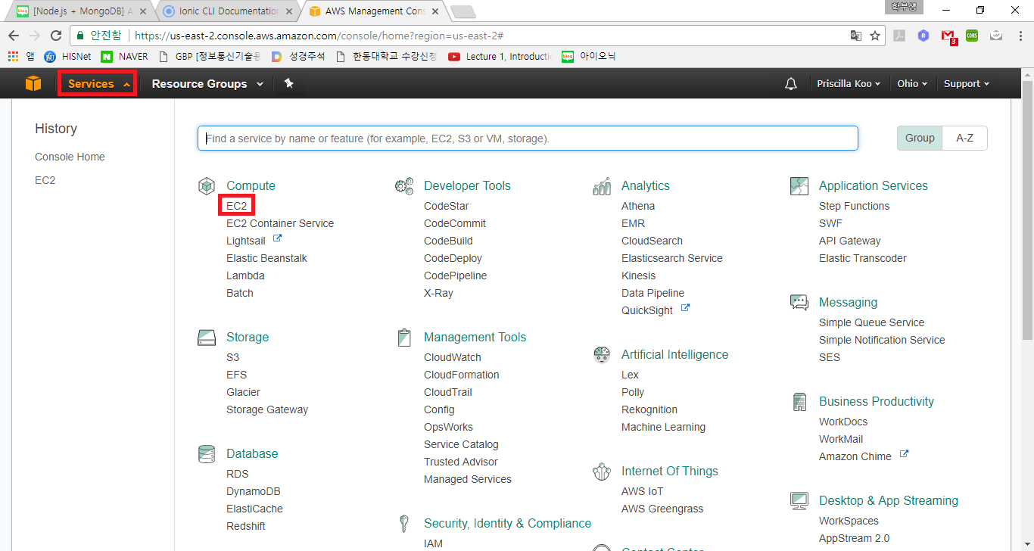
8.1 Create an instance in EC2
8.1.1 Create EC2 instance in AWS
Click on service and then click EC2

Slide 7
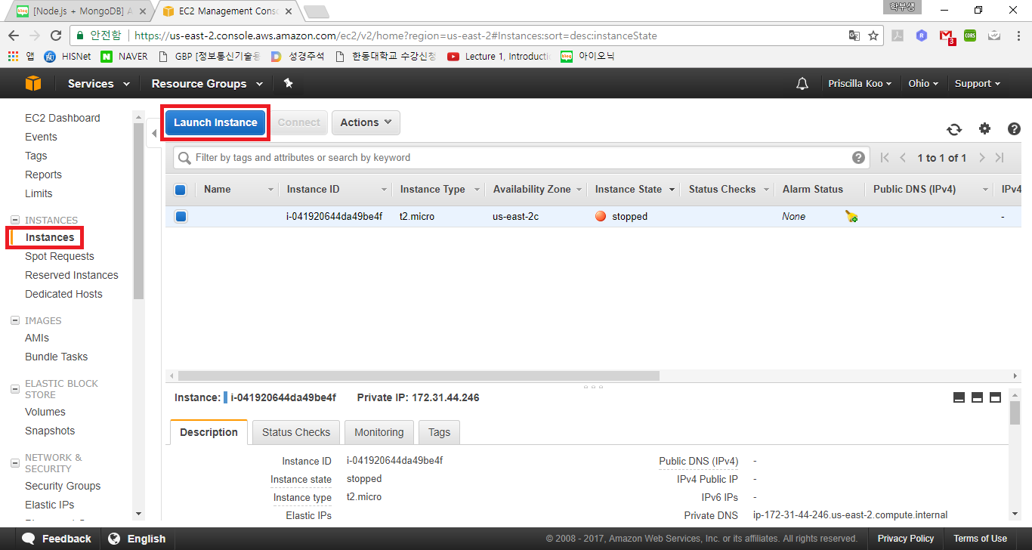
8.1 Create an instance in EC2
8.1.1 Create EC2 instance in AWS
Click “INSTANCE>instance” and click “Launch instance”

Slide 8
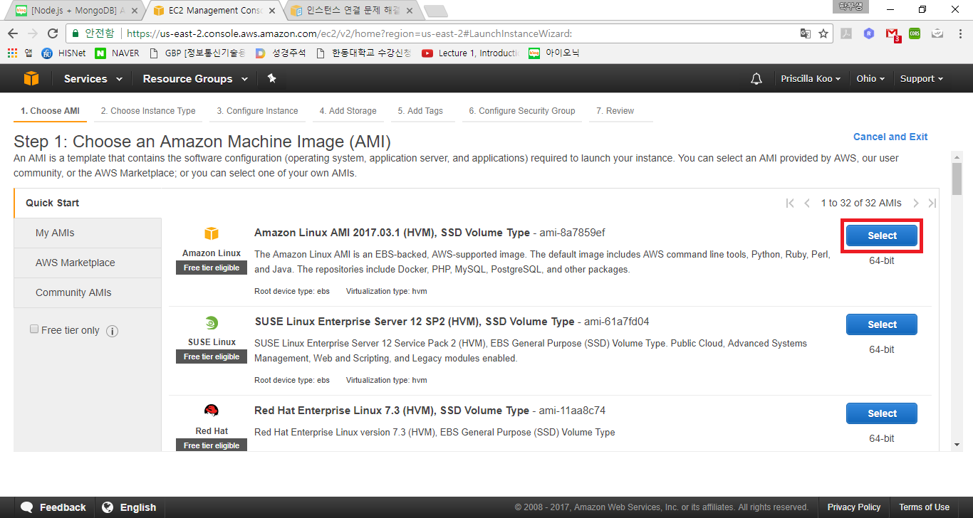
8.1 Create an instance in EC2
8.1.1 Create EC2 instance in AWS
Click “Amazon Linux AMI”

Slide 9
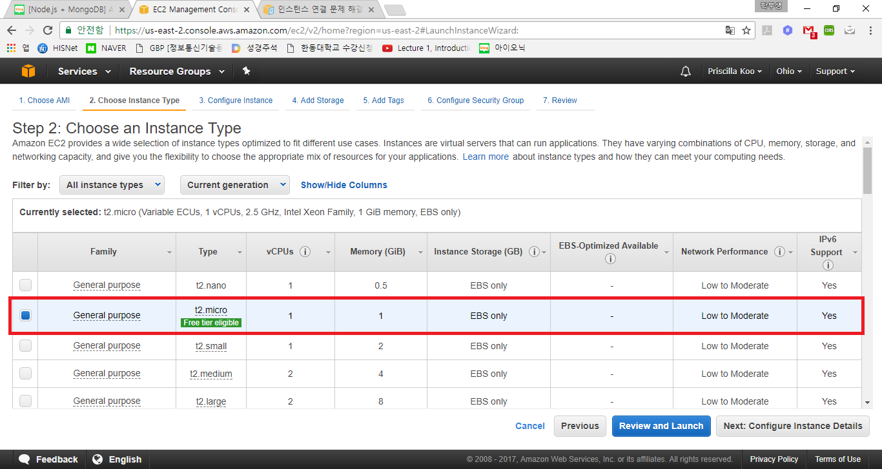
8.1 Create an instance in EC2
8.1.1 Create EC2 instance in AWS
Click “Free tier” and skip to step 6

Slide 10
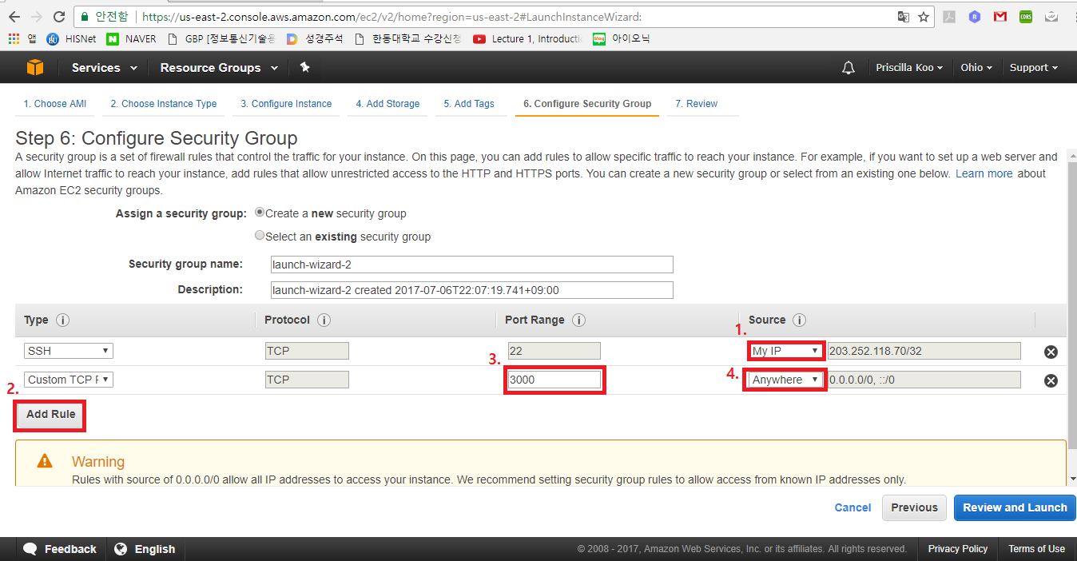
8.1 Create an instance in EC2
8.1.1 Create EC2 instance in AWS
In step 6, set like below
The reason for setting “anywhere” is to allow access to other IPs as well as my IP

Slide 11
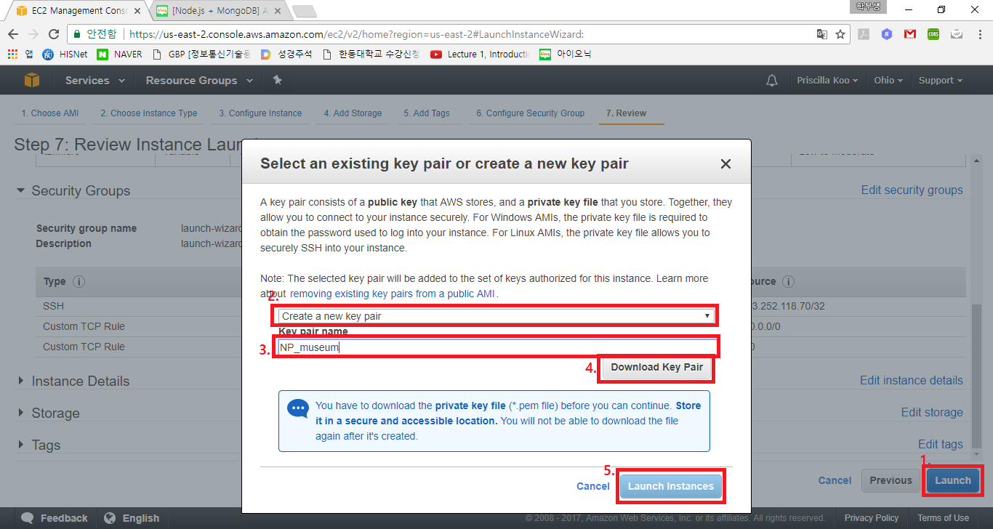
8.1 Create an instance in EC2
8.1.1 Create EC2 instance in AWS
And then, set like below

Slide 12
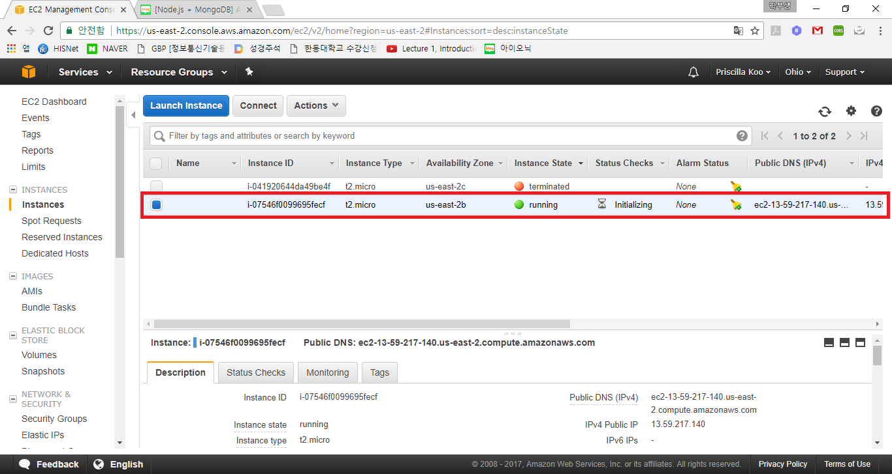
8.1 Create an instance in EC2
8.1.1 Create EC2 instance in AWS
Click “View instance” to confirm the instance

Slide 13
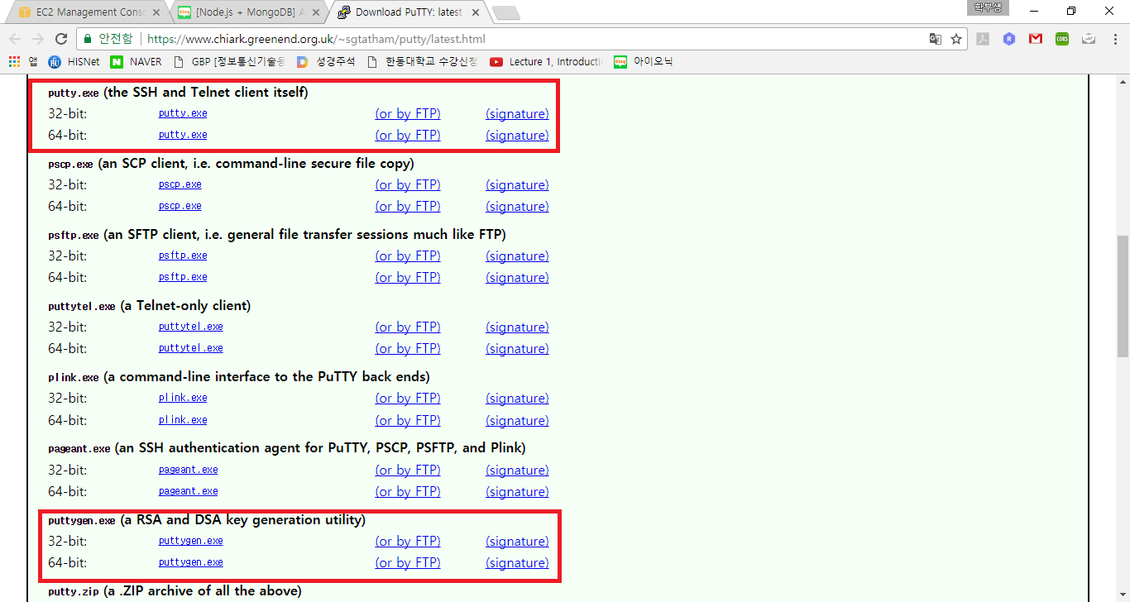
8.1 Create an instance in EC2
8.1.2 Access created instance using Putty
Go to link(https://www.chiark.greenend.org.uk/~shtatham/putty/latest.html) and download putty.exe and puttygen.exe

Slide 14
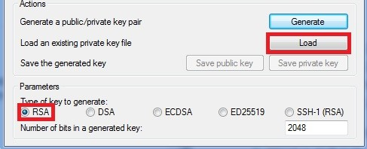
8.1 Create an instance in EC2
8.1.2 Access created instance using Putty
Run Puttygen, set Type of key to generate to RSA
Press load to load AWS generated pem key file and press Save private key

Slide 15
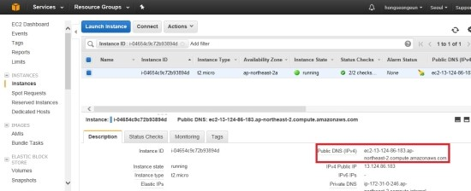
8.1 Create an instance in EC2
8.1.2 Access created instance using Putty
To access instance using ppk file and Putty, copy the public DNS

Slide 16
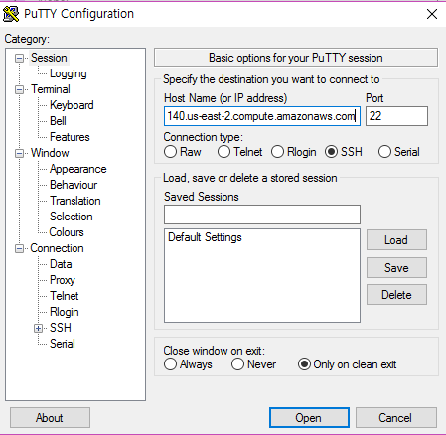
8.1 Create an instance in EC2
8.1.2 Access created instance using Putty
Type “user_name@public_dns_name” in Host Name
Put “ec2-user” in “user_name” and put “public DNS” copied in “public_dns_name”

Slide 17
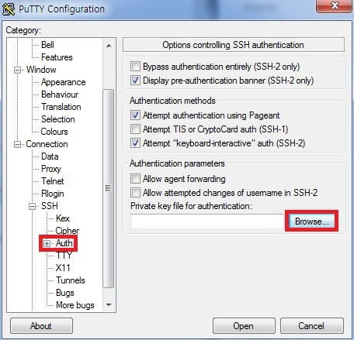
8.1 Create an instance in EC2
8.1.2 Access created instance using Putty
Confirm port 22 dedicated to SSH
Go to “Auth” in the left “SSH” tab subclass and click “Browse” to load the ppk file and click “Open”

Slide 18
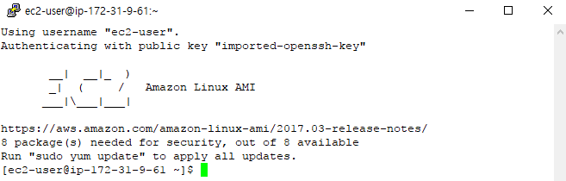
8.1 Create an instance in EC2
8.1.2 Access created instance using Putty
If you click “Yes” and this window appears, you are connected to instance with Putty

Slide 19
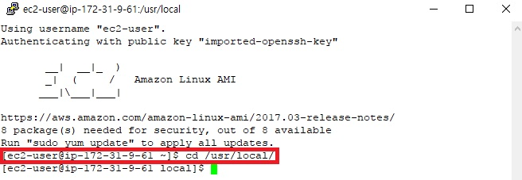
8.2 Install stack in EC2 instance
Go to the “/usr/local/” directory with “cd /usr/local/”

Slide 20
8.2 Install stack in EC2 instance
8.2.1 Install git
Install git with command “sudo yum install git”

Slide 21
8.2 Install stack in EC2 instance
8.2.1 Install git
Create a folder to receive project with “sudo mkdir example”
example is folder name
Go to the folder with “cd example”

Slide 22
8.2 Install stack in EC2 instance
8.2.1 Install git
Download git project with “sudo git clone http://github.com/qkstnrshfmswk/hd_museumS.git”
http://github.com/qkstnrshfmswk/hd_museumS.git is address of git project

Slide 23
8.2 Install stack in EC2 instance
8.2.2 Install Node.js
Go to /usr/local/ directory with “cd /usr/local/”
Type “sudo su”

Slide 24
8.2 Install stack in EC2 instance
8.2.2 Install Node.js
Type “wget http://nodejs.org/dist/v4.6.1/node-v4.6.1-linux-x64.tar.gz”

Slide 25
8.2 Install stack in EC2 instance
8.2.2 Install Node.js
Type “tar zxvf node-v4.6.1-linux-x64.tar.gz”

Slide 26
8.2 Install stack in EC2 instance
8.2.2 Install Node.js
Type “cd ./node-v4.6.1-linux-x64”

Slide 27
8.2 Install stack in EC2 instance
8.2.2 Install Node.js
Type “cp –rf ./* /usr”

Slide 28
8.2 Install stack in EC2 instance
8.2.2 Install Node.js
Type “source ~/.bash_profile”

Slide 29
8.2 Install stack in EC2 instance
8.2.2 Install Node.js
Make sure it is installed properly with “node -v”

Slide 30

8.2 Install stack in EC2 instance
8.2.3 Install MongoDB
Download installation file with “wget http://fastdl.mongodb.org/linux/mongodb-linux-x86_64-2.6.1.tgz”

Slide 31
8.2 Install stack in EC2 instance
8.2.3 Install MongoDB
Unzip the file with “tar zxvf mongodb-linux-x86_64-2.6.1.tgz”

Slide 32
8.2 Install stack in EC2 instance
8.2.3 Install MongoDB
Rename unzipped folder with “mv mongodb-linux-x86_64-2.6.1 mongodb”

Slide 33
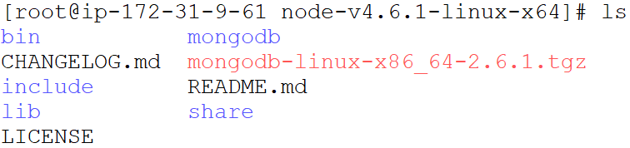
8.2 Install stack in EC2 instance
8.2.3 Install MongoDB
Check with “ls”

Slide 34
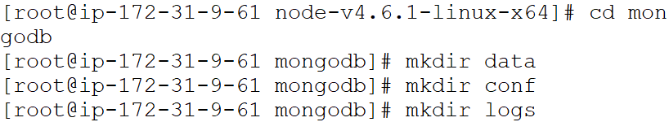
8.2 Install stack in EC2 instance
8.2.3 Install MongoDB
Go to mongoDB directory with “cd mongodb”
And create 3 directories for next work with “mkdir data”, “mkdir conf”, “mkdir logs”

Slide 35
8.2 Install stack in EC2 instance
8.2.3 Install MongoDB
Go to conf directory with “cd conf”

Slide 36
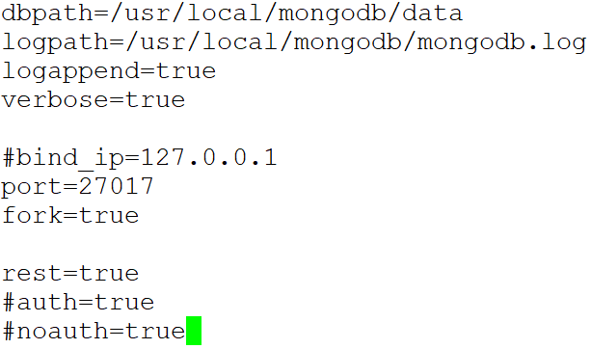
8.2 Install stack in EC2 instance
8.2.3 Install MongoDB
Create a file in conf directory to hold information about mongodb with “vi mongodb.conf”
And insert code below in the created mongodb.conf file

Slide 37
8.2 Install stack in EC2 instance
8.2.3 Install MongoDB
Check if it works normally via mongodb path
Go to mongodb/bin directory with “cd mongodb/bin”
And type “./mongod –dbpath ../data”

Slide 38
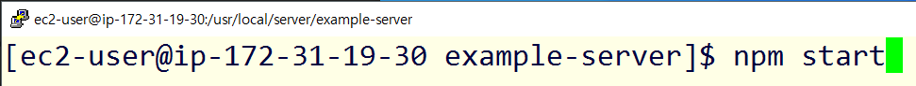
8.3 Create Web Server in EC2
Go to the project file received via git clone with “cd museum-server”
museum-server is project name
Run Node.js through “npm start”

Slide 39
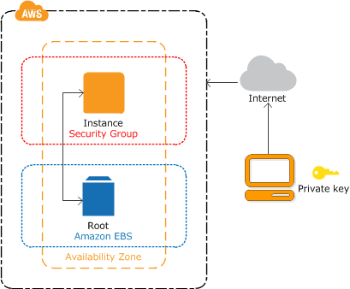
Summary
We learned how to create a web server by creating an EC2 instance in AWS
We learned installing stack in EC2 instance
(http://docs.aws.amazon.com)

